Slide 1
Project 67: Evaluating Identifier Quality
By Jack Chu & Jafar Maash
Supervisor: Ewan Tempero

Slide 2
The problem
Having good identifiers is important for developing comprehensible code
People generally do not have good identifiers
Those who do follow naming guidelines only do it to an extent of their own choosing.
Increases maintenance costs

Slide 3
Literature review

Slide 4
What does it mean for an identifier to be meaningful?
Shorter identifier names take longer to comprehend, poor naming leads to more maintenance
Higher quality code metrics come from better programming practices
identifiers are often constructed out of dictionary words or abbreviations
Identifiers define their meaningfulness through the identifiers ability to describe themselves
Analysis of these identifier names show that they are arbitrary sequences of characters
Leads to meaningless, or even misleading naming

Slide 5
Technical analysis of identifier naming guidelines
Many researchers have developed their own tools and methods to evaluate identifier metrics, which is an essential part of backing up their claims.
This is also important to provide necessary data to inform themselves and other researchers on their findings
Example:
A tool that was developed to infer semantically related words in software by leveraging the context of words in the code / comments
Achieved high precision and recall, was considered state of the art
However, software semantics are different to spoken language semantics
Many identifier evaluating techniques often result in false alarms.

Slide 6
Experimental analyses of identifier naming guidelines
Other empirical studies done through surveys and experiments also provide evaluation for identifier metrics.
Most famous example:
Experiment conducted by D. Lawrie, involving over 100 programmers
They were asked to distinguish between three “levels” of identifiers:
Single letters
Abbreviations
Full words
Results showed that code comprehension almost solely relied on identifier naming
Full word identifiers lead to the best comprehension, however there is no statistical difference between abbreviations and full words

Slide 7
Experimental analyses of identifier naming guidelines (cont.)
A study by A. De Lucia et al involved two controlled experiments used to evaluate the quality of identifiers and comments
one using COde COmprehension Nurturant Using Traceability (COCONUT), and one without
COCONUT is an Eclipse plugin that recommended candidate identifiers built from high-level artifacts
Artifacts are items produced during the development process.
This can be a data model, a prototype, workflow diagram, a design document, or a setup script
The results confirmed similarity between artifacts and code, which helped improve the source code quality, showcasing the potential of COCONUT.

Slide 8
Notable papers

Slide 9
P.A. Relf, “Achieving Software Quality through Source Code Readability” - 2005
21 Java identifier naming guidelines
Tested the guidelines on developers
2010 study found not following these guidelines lead to worse code
Only evaluated approx. half of the original guidelines
Also evaluated outdated/challenged guidelines
E.g. min length 8 characters
Difference in commercialised projects
“Complex” relationship
Notes:
2010 found Violating guidelines lead to:
Increased complexity
Decreased readability
Decreased maintainability
More warnings in static analysis
but only in commercialised projects, relationship “complex” and “application-specific”
Could explore other variables to explain the relationship

Slide 10
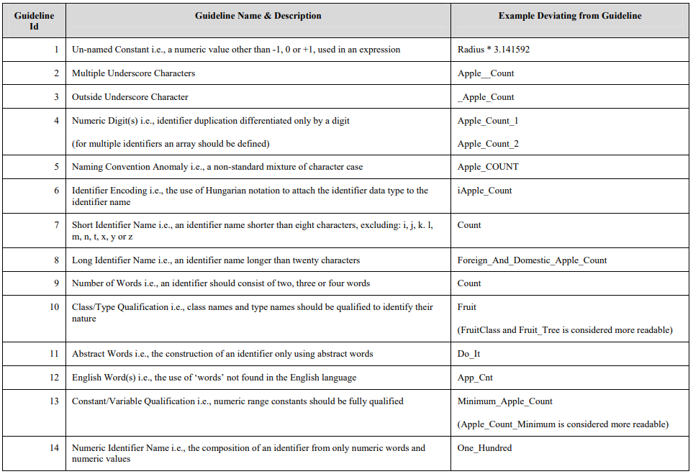
Notes:
The challenged remaining three were:
- Identifier names shouldn’t be shorter than 8 characters, with the exception of some commonly used single letters
(e.g. b for byte)
- Duplicate identifiers should not be differentiated only by a digit, e.g. apple_count_1, apple_count_2
- Class names and type names should be qualified to identify their nature, e.g. FruitClass instead of Fruit

Slide 11
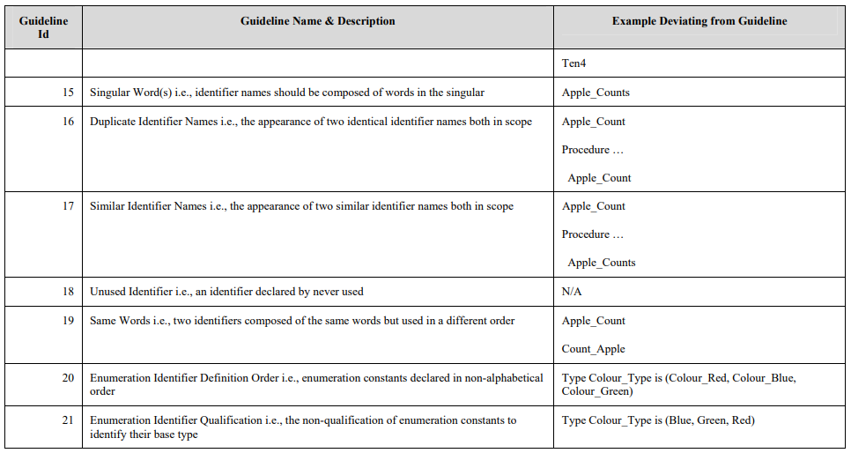
Notes:
The challenged remaining three were:
- Identifier names shouldn’t be shorter than 8 characters, with the exception of some commonly used single letters
(e.g. b for byte)
- Duplicate identifiers should not be differentiated only by a digit, e.g. apple_count_1, apple_count_2
- Class names and type names should be qualified to identify their nature, e.g. FruitClass instead of Fruit

Slide 12
Deißenbock and Pizka, “Concise and consistent naming” - 2006
2 key guidelines
Consistency
No homonyms
file: File handle or file name?
No synonyms
accountNumber & number
Conciseness
Identifiers names being exactly the concept they represent
Using transformation to represent permutation
2007 study found ~20% of identifiers violated these guidelines
open vs closed source
Release year had effect
Notes:
Homonym e.g. “book” a flight, or read a “book”
E.g. using file for file handles and filenames alike
synonym , e.g. using accountNumber and number to represent the concept of an account number in multiple places in the code.
Conciseness. E.g. using transformation to represent permutation
A concept is a unit with an associated meaning in terms of behavior or properties.

Slide 13
Binkley, Hearn, and Lawrie, “Improving identifier informativeness using part of speech information” - 2011
Non-boolean field names should not contain a present tense verb
create_mp4 -> created_mp4_container_type
Field names should never be only a verb
recycle -> recycled_count or things_recycled
Field names should never be only an adjective
interesting -> interesting_items
Boolean field names should contain third-person forms of the verb “to be” or the auxiliary verb “should”
deleted -> is_deleted or was_deleted
Violated by up to 19% of identifiers in source code
Didn’t consider distribution of violations over programs and time
Notes:
create_mp4
Appears to imply an action, but actually held the desired mp4 video stream container type
recycle
Examination of the source code reveals that this variable is an integer and, based on the comments, it counts the “number of things recycled.”
Interesting -
Seeing declaration of a list found to hold “interesting” items. Renaming this to e.g. interesting_items removes the need to uncover the declared type and thus should improve code understanding.
Exception for 3 is e.g. “next” when working with a linked list
deleted
The identifier deleted offers a good example. If you dont know its type, does it represent a pointer to a deleted thing or perhaps a count of deleted things? Upon closer inspection of the source code it was found to represent whether or not something was deleted. Thus potential improved names include is deleted or was deleted.

Slide 14
The Java Language Specification: Java SE 8 Edition - 2015
Most modern of all the popular guidelines
Defines part of speech rules
For methods, fields, constants, etc.
Hasn’t been evaluated before in the literature
Notes:
Does POS rules for more than just fields, unlike binkley hearn and lawries work

Slide 15
Limitations of previous work
No literature evaluating guidelines since 2010
Java language spec has not been evaluated
Opportunities to evaluate how modern applications/source code adheres to guidelines, over a decade on
Opportunities to explore relationships between adherence and
Class/method size
Time of development
Code quality
Project size
Open/closed source
Opportunity to see if following one guideline is best
Or combine multiple guidelines

Slide 16
Research Intent
We wish to answer the question :
“How closely do developers follow rules and guidelines when naming identifiers?”
Are there any patterns when it comes to identifier naming?

Slide 17
Plan moving forward
Develop code to extract identifiers from source
Javaparser
Categorise/analyse identifiers
Part of speech
Length
Casing
Compare results using different explanatory variables (pre/post introduction of IDEs, etc)
Investigate relationship between class/method names and their respective identifiers

Slide 18
Questions!

